Slide 1
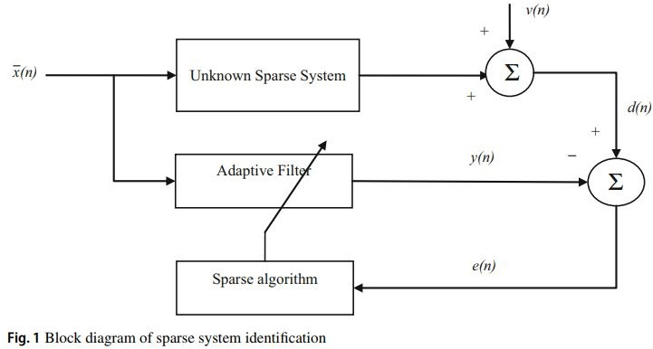
Sparse System Identification :
It is known that the conventional adaptive filtering algorithms can have good per- formance for non-sparse systems identification, but unsatisfactory performance for sparse systems identification. The normalized least mean absolute third (NLMAT) algorithm which is based on the high-order error power criterion has a strong anti- jamming capability against the impulsive noise, but reduced estimation performance in case of sparse systems
Exploiting sparsity :
Zero-Attracting NLMAT Reweighted zero-attracting NLMAT Reweighted l1-nprm NLMAT
Non-Uniform Norm Constraint NLMAT Correntropy0Induced Metric CIM-NLMAT
I implemented NNC-NLMAT with following additions : Proportionality Constraint
Set-Membership Constraint
NLMAT :

Slide 2
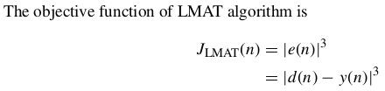
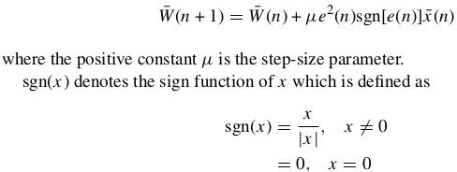
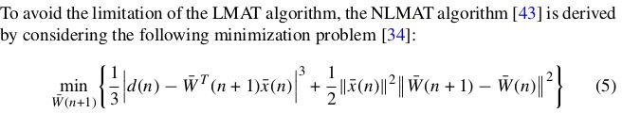
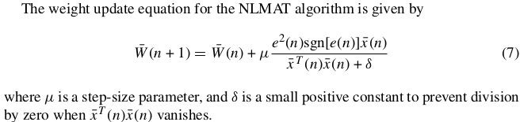
The weight update rule of LMAT is given as
The drawback of the LMAT algorithm is that its convergence performance is highly dependent on the power of the input signal.
Non-Uniform Norm Constraint :
In order to further improve the performance of sparse system identification, the non-

Slide 3





uniform p-norm-like constraint is incorporated into NLMAT algorithm.
the p-norm-like constraint will cause
an estimation error for the desired sparsity exploitation. To solve this problem, the non-uniform p-norm-like definition which uses a different value of p for each of the L entries in W̄ (n) is provided,
Proportionality Constraint :
The updating equation of the PNLMS algorithm can be described as ;-
where μ is an overall step size, and ε is a small regularization parameter. Q ( n − 1 ) is the step size
assignment matrix, which is diagonal and can be described as

Slide 4

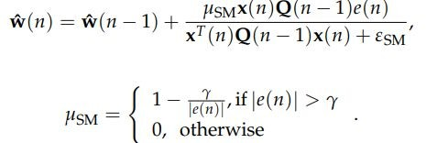
The elements in Q ( n − 1 ) are calculated by
Set-Membership Constraint :
The updating equation of the SM-PNLMS is
The Algorithm :

Slide 5
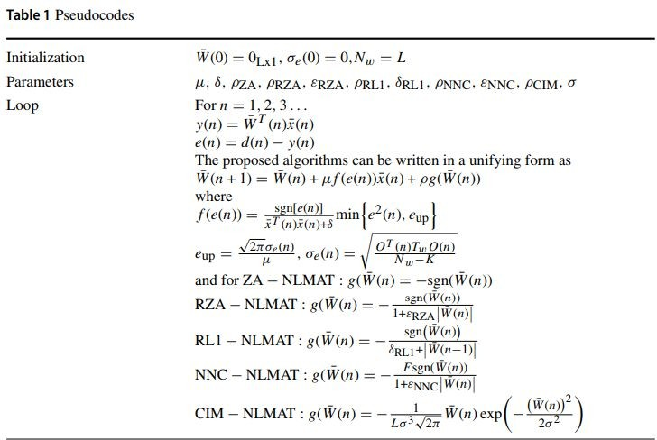
Correlated Results :
Input and noise correlated
Results look similar to the ones in the paper.A proper comparison is yet to be done.
Uncorrelated Results :
Input and noise uncorrelated
Results look similar to the ones in paper.A proper comparison is yet to be done.

Slide 6
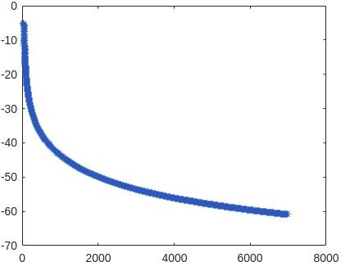
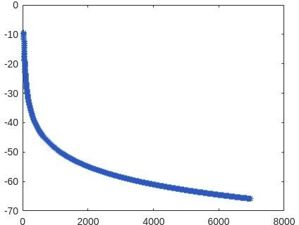
Correlated
Uncorrelated
Their results :

Slide 7
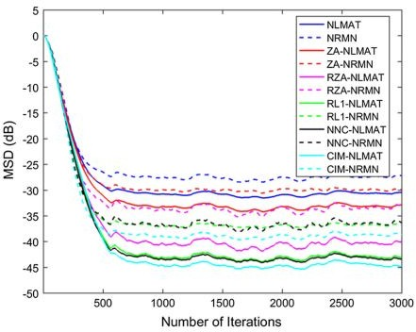
Remainder :
Comparing the results for various noise models among themselves and that of the paper;
Understanding the algorithms
Understanding why they perform better than LMS ;

